Slide 1
Quiz Application
CSD 3444 EMERGING TECHNOLOGY
(Final Group Project)

Slide 2
Technology Used
Server Side Language :
Framework :
Database :
Client Side Language :
Python
Flask
MongoDB
HTML,CSS

Slide 3
Project Objective
This application has been made for students.
Student can register them self in this application.
After registration student can select the subject
Students could also see the highest result.

Slide 4
Why Flask?
Light Weight framework compare to other framework
Very easy to build web application for new beginners
Provides reliable , scalable and maintainable web application.
Provides more extensions for common operations

Slide 5
Why MongoDB
Schema free
Allow to create documents without defining structure
New fields can be added at any time
Do not require to define datatypes for data
Allowed to have the same key used within other documents.

Slide 6
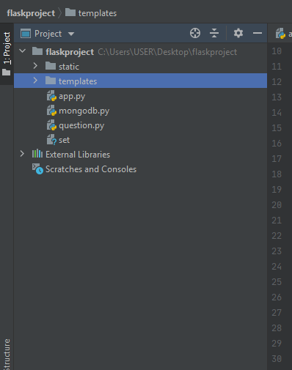
Folder Structure

Slide 7
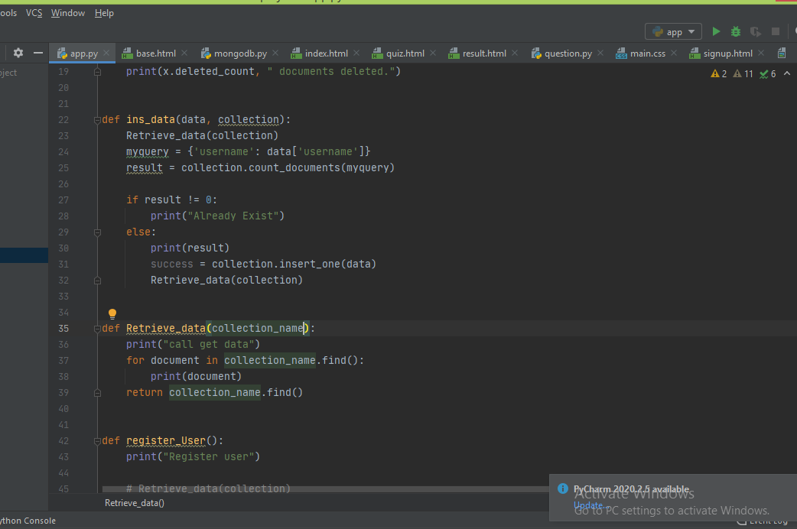
Code Example

Slide 8
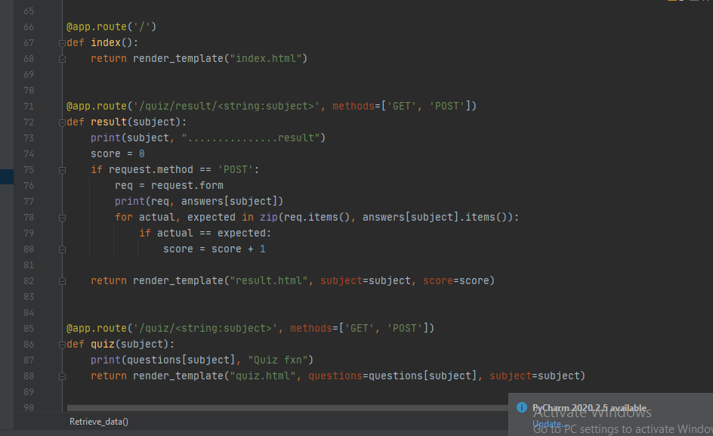
Continue….

Slide 9
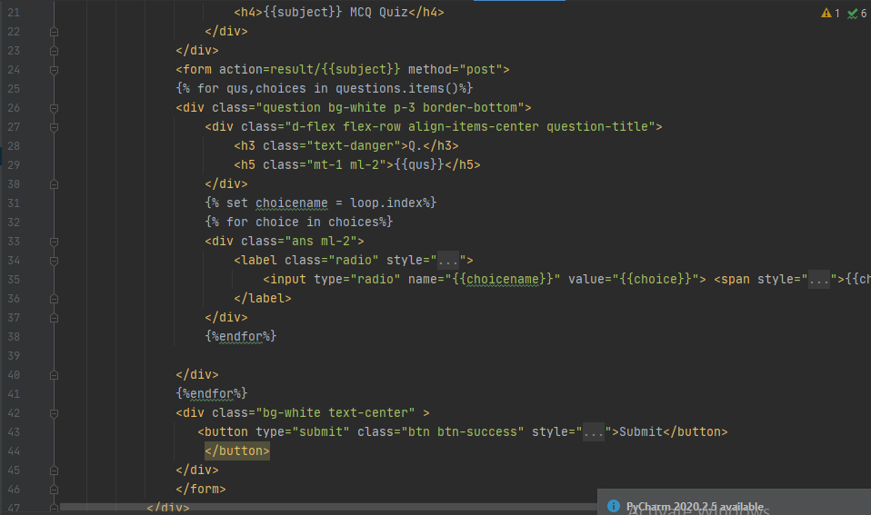
Continue..

Slide 10
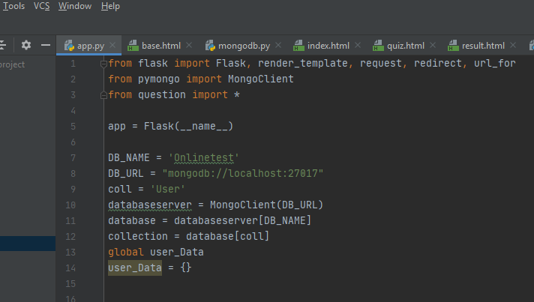
Database Connection

Slide 11
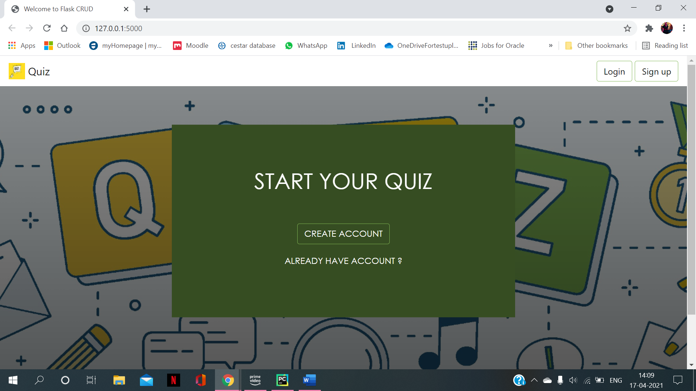
Home Page

Slide 12
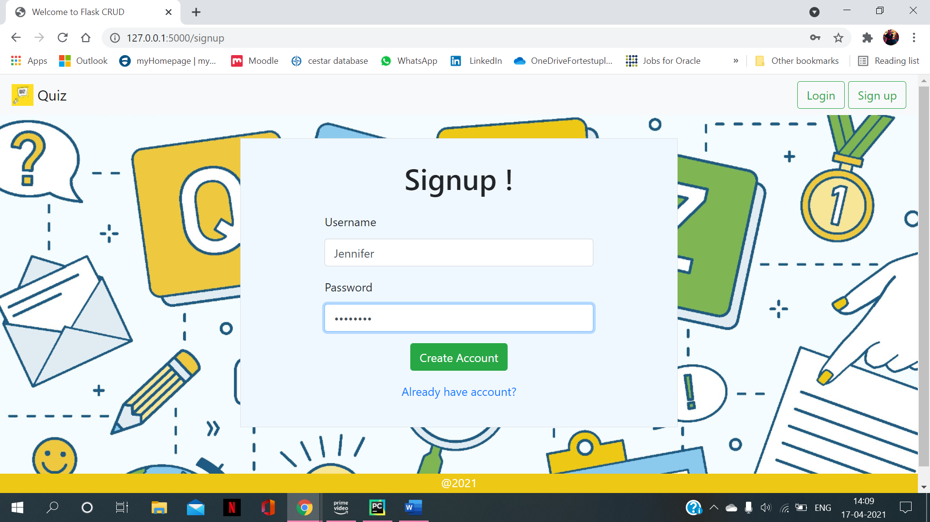
Sign Up

Slide 13
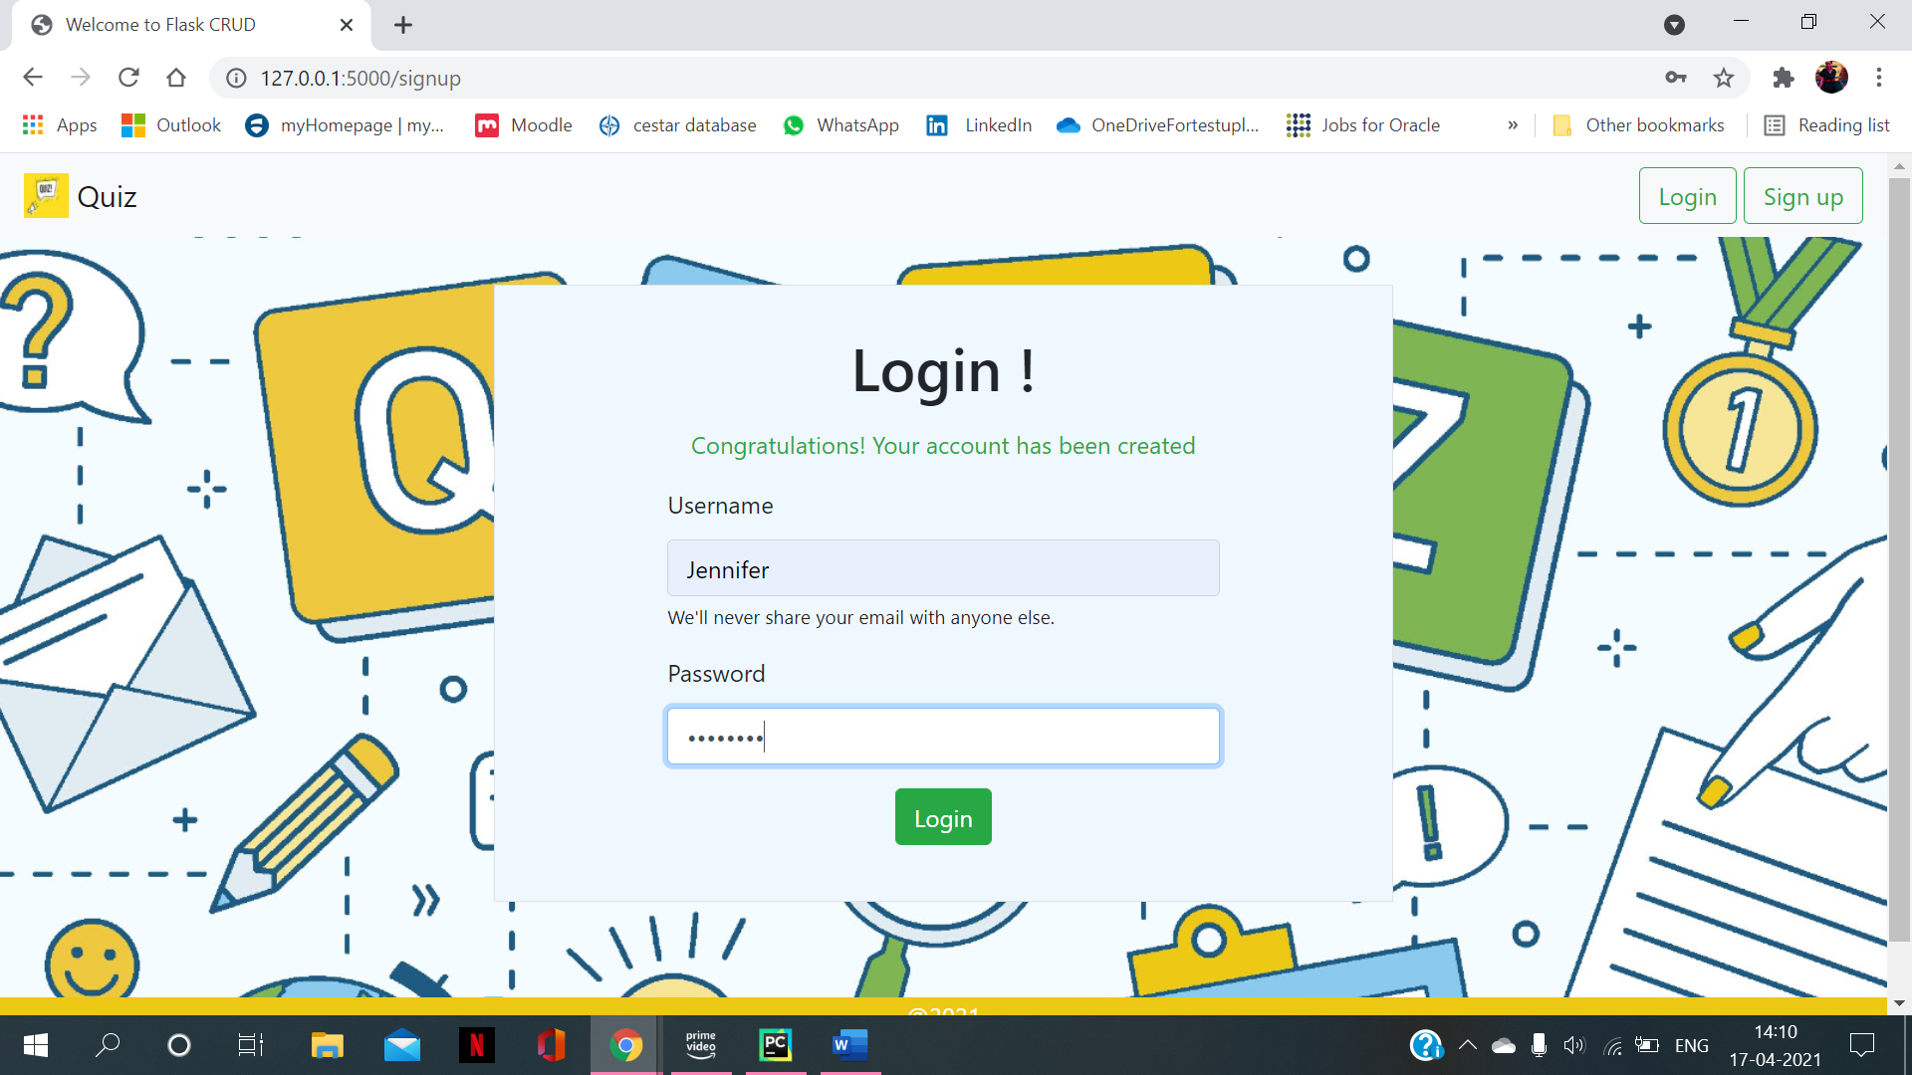
Login

Slide 14
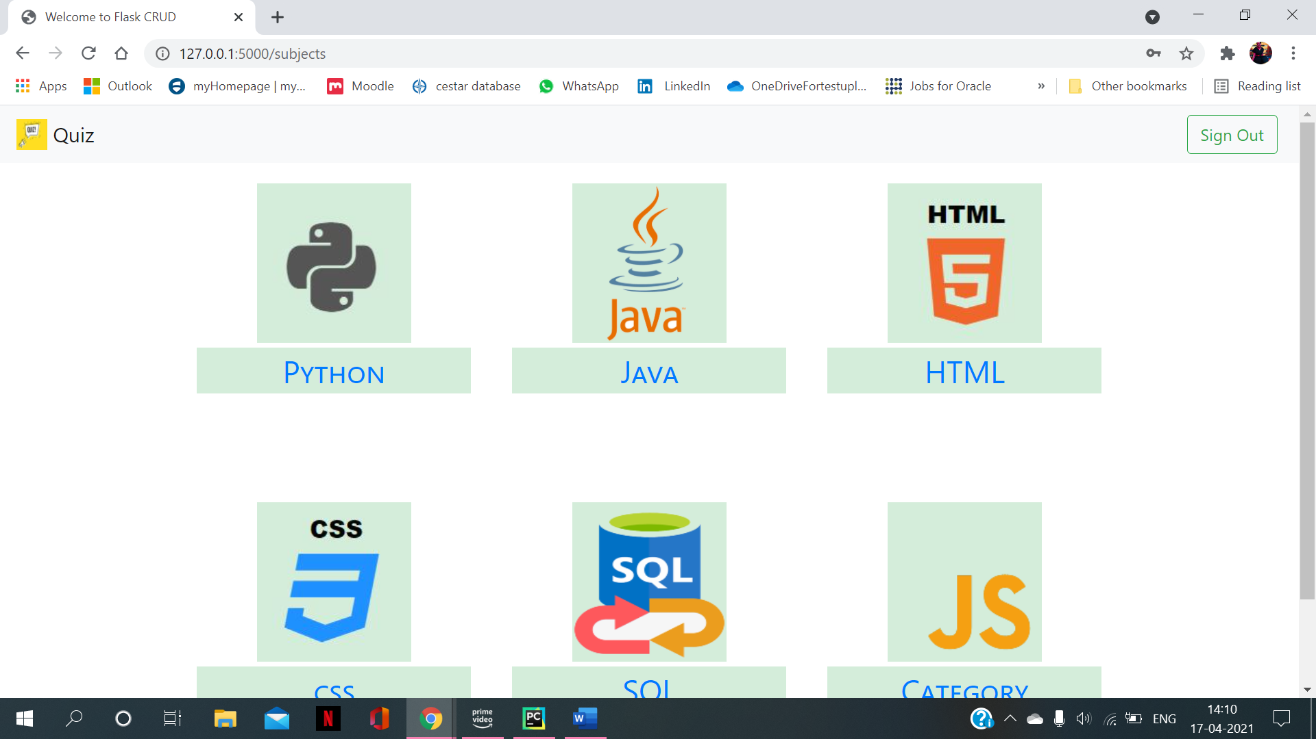
Subject Selection

Slide 15
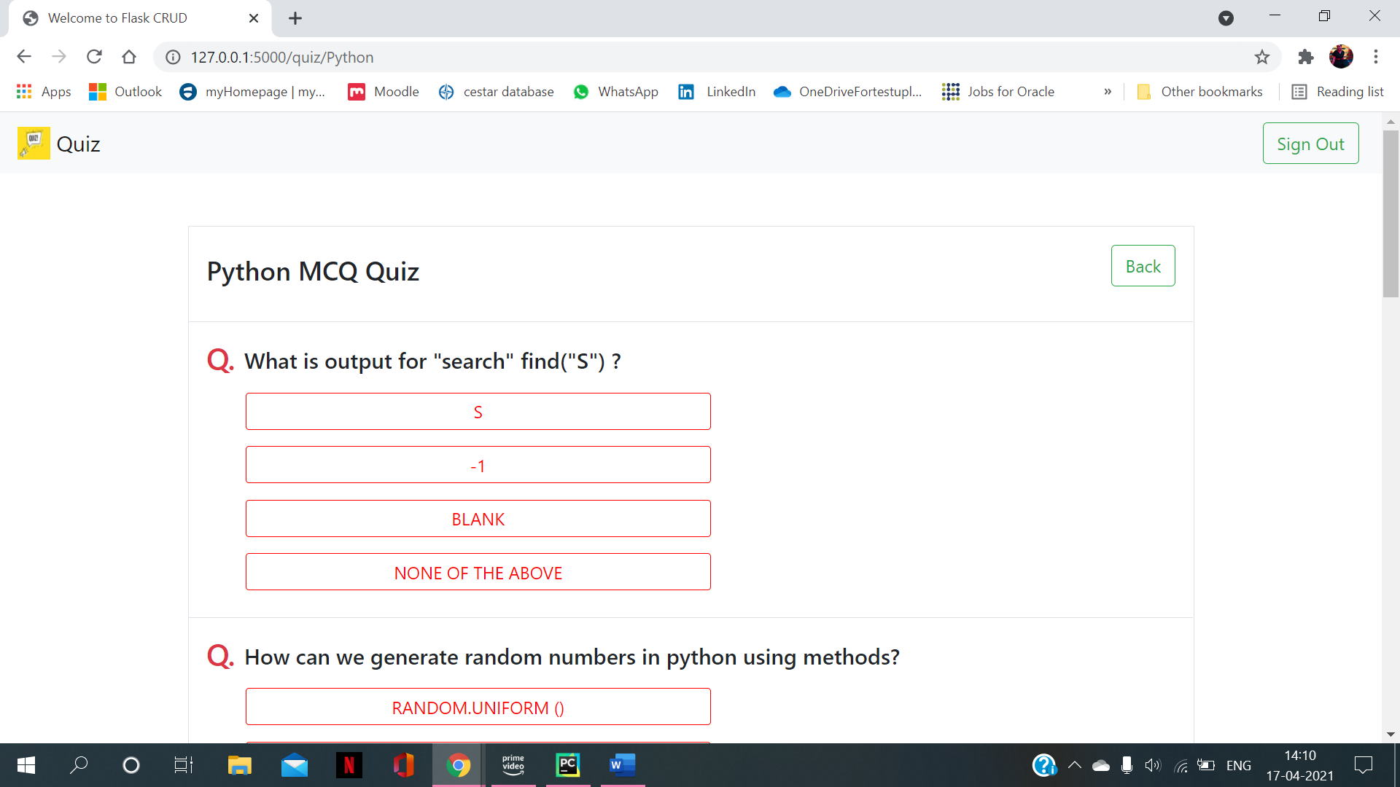
Question & Answers

Slide 16
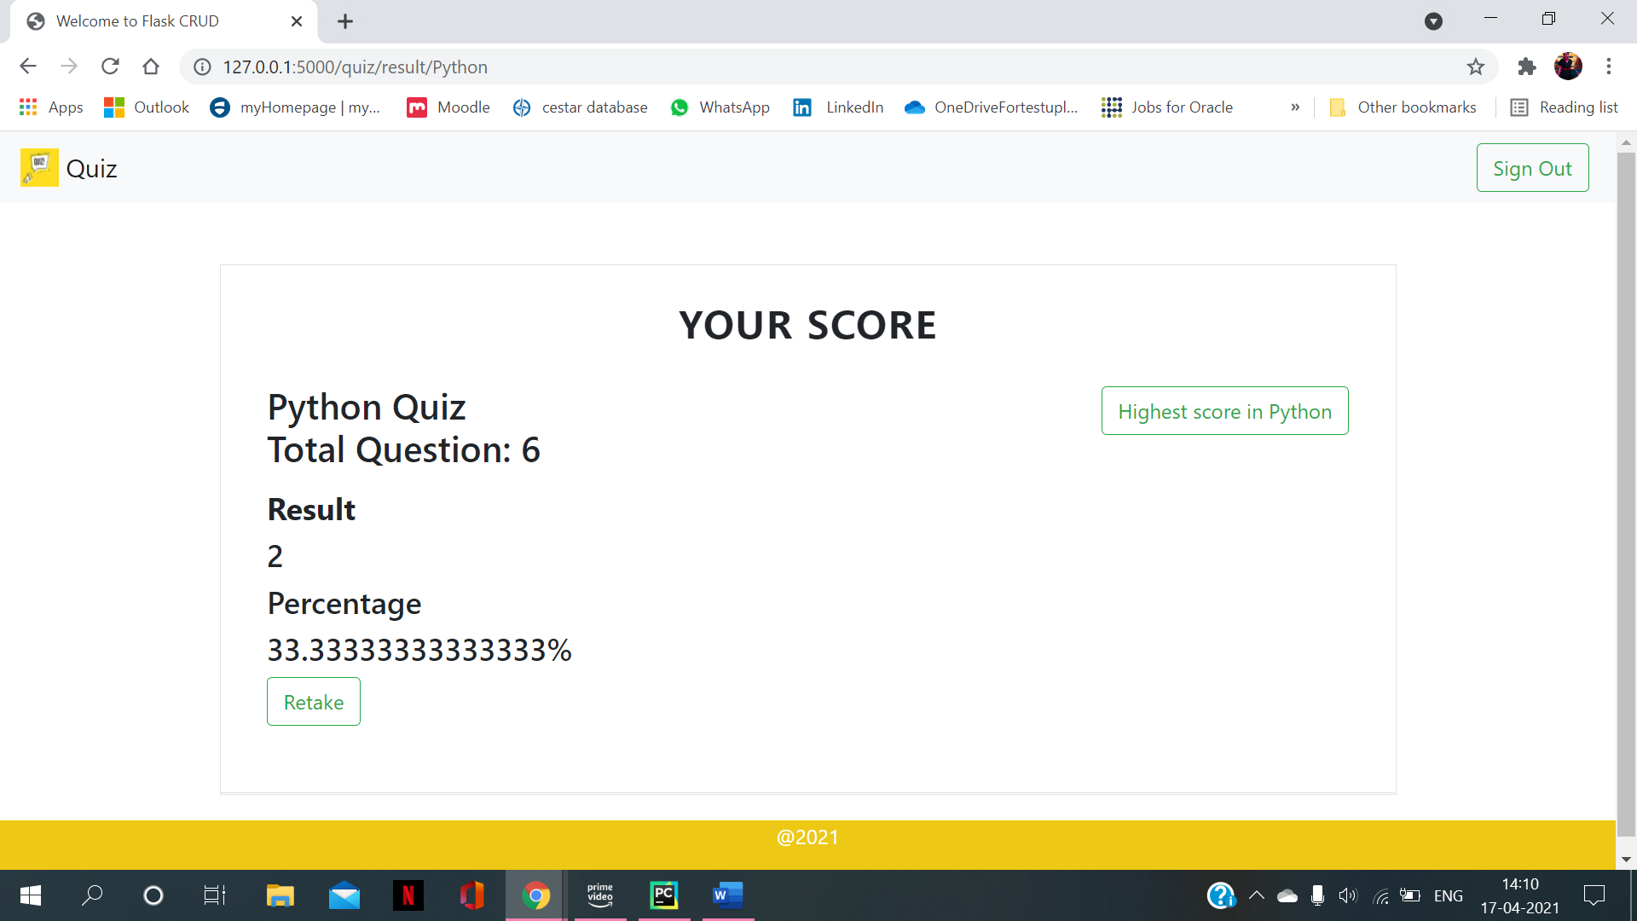
Student Result

Slide 17
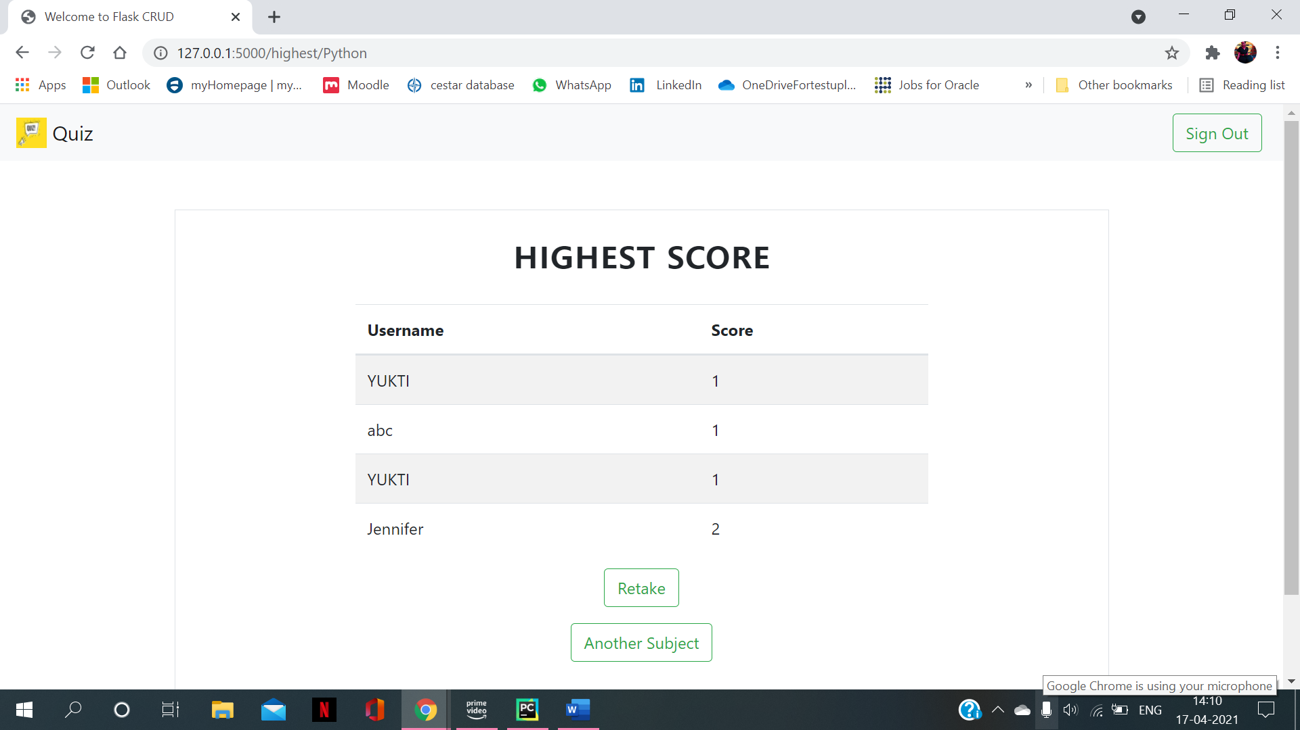
Highest Score

Slide 18
Thank you
Richa - C0780770
Yukti - C0780739
Parmeet - C0783627
Ravneet - C0789781
Sunil - C0785564

